Slide 1
Domain Driven Refactoring
as named by Jimmy Bogard, not me :)

Slide 2
About me

Slide 3
Poka-yoke
Poka-yoke

Slide 4
Poka-yoke in press shop

Slide 5
Poka-yoke in home heating

Slide 6
Poka-yoke in C#
Give me an example...

Slide 7
Object-oriented programming
A programming paradigm based on the concept of objects,
which can contain data and code

Slide 8
Object-oriented programming
LISP
Sketchpad
Simula 67

Slide 9
Object-oriented programming
Where do you use it?

Slide 10
Object-oriented programming
Where have I used it?

Slide 11
Domain Driven Design
This is not about DDD!!!

Slide 12
Domain Driven Design
Object model of business (Jimmy Bogard)
Object-oriented design done right (someone)

Slide 13
Domain Driven Design
Bounded context

Slide 14
Domain Driven Design
Domain Entity

Slide 15
Domain Driven Design
Aggregate Root - transaction boundary

Slide 16
Domain Driven Design
Domain Service

Slide 17
Domain Driven Design
Domain Event

Slide 18
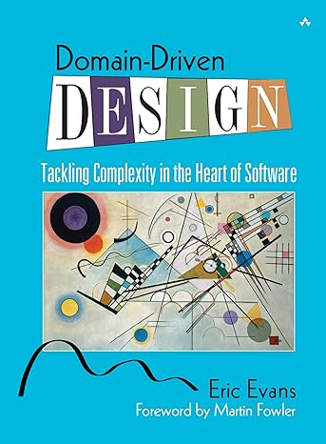
Domain Driven Design
Tackling Complexity in the Heart of Software - Eric Evans

Slide 19
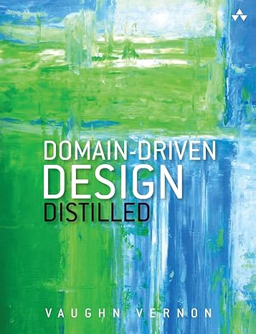
Domain Driven Design
Domain Driven Design Distilled - Vaughn Vernon

Slide 20
Event Storming
Event Storming - Alberto Brandolini - Youtube
Event Storming - what it is and why you should use it with Domain-Driven Design (youtube.com)

Slide 21
Poka-yoke in your application
Domain-Driven Refactoring - Jimmy Bogard - Youtube
https://github.com/MirkoMilenkovic/DDDRefactoring

Slide 22
Thank You !!!

